Slide 1
CSS
MCNDHS
Ms. Eng

Slide 2
aim: what are the properties of css?
Do now:
Log into google classrooms
Daily Grade:
On-time/attendance/not leaving the classroom: 25%
Cellphones: 25%
Notes:25%
Classwork/Homework: 25%

Slide 3
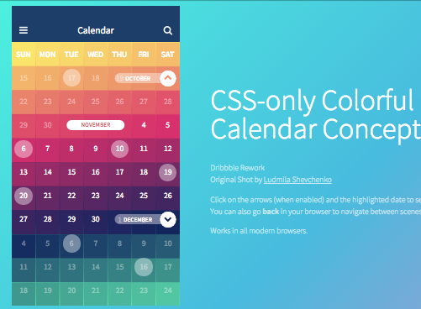
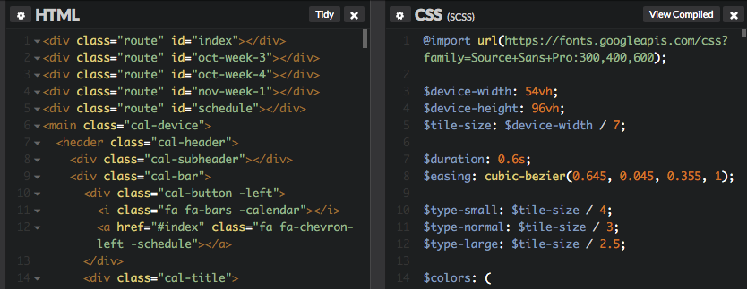
how does css work

Slide 4
adjust by tag
Step 1:
Name the tag you want to adjust.
Step 2:
Insert the information you want to change.

Slide 5
css attributes
color:
use hexadecimal
fonts:
name of the font, then family font

Slide 6

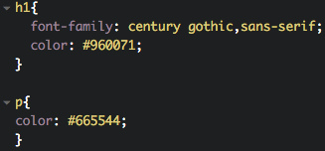

example:

Slide 7
activity:
1) write 5 headers and change the:
text
font

